Slide 1
Progress on ArII DB shot to shot analysis and Analyzed Tree
Pawel Piotrowicz
Josh Beers
Elizabeth Linquist

Slide 2
Agenda
Propose Tree Structure
Code for shot-to-shot Data Analysis
Error Analysis

Slide 3
Proposed Tree Structure
NAME DIMENSIONS DATATYPE WHAT?
ArII_Ti [5,frames] double Ion temp [eV] from ArII DB
HeII_Ti [5,frames] double Ion temp [eV] from HeII DB
Err_ArII_Ti [5,frames] double Error in Ion temp [eV] from ArII DB
Err_HeII_Ti [5,frames] double Error in Ion temp [eV] from HeII DB
Time [frames] double Experimental time vector
Position [5] cell/string Description of the position of the fiber
Notes [5] cell/string Notes of the measurement day
Center_lambda [5] double McPherson’s centered lambda
IF_FWHM [5] double Calibrated FWHM of IF [meters]
Intensity [5,512,frames] double Processed and normalized intensity
Intensity_Fit [5,512,frames] double Intensity data predicted by the fit params
Lambda [512] double Vector corresponding to wavelength [meters]
ArII_shift [5,frames] double Doppler shift for calculating flow [meters]
HeII_shift [5,frames] double Doppler shift for calculating flow [meters]
Position_vect [5,5] double Vector describing position for each fiber

Slide 4
What??
Wrote code to process data faster and spit it out into MPEX tree after a shot.
  New script takes <30 seconds to analyze 1 shot
  Fully automated data analysis
  Old analysis took ~ 45 min to analyze shot with minor input from student
  Elijah’s code takes ~10s per data set so 5x60 data array ~50 minutes

Slide 5
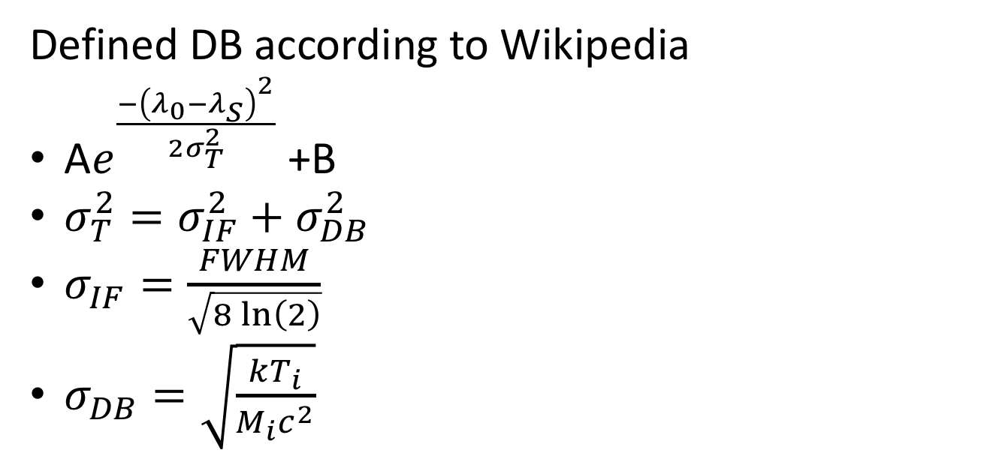
My Analysis
Defined DB according to Wikipedia
A$e^{\frac{{−\left(λ_{0}−λ_{S}\right)}^{2}}{2σ_{T}^{2}}}$ +B
$σ_{T}^{2}=σ_{IF}^{2}+σ_{DB}^{2}$
$σ_{IF}=\frac{FWHM}{\sqrt{8\ln\left(2\right)}}$
$σ_{DB}=\sqrt{\frac{kT_{i}}{M_{i}c^{2}}}$
I use “lsqcurvefit” in Matlab to fit this function to the data. This increases the efficiency of finding a fit. The problem does not seem to have a local minima’s if the boundaries are defined properly.

Slide 6
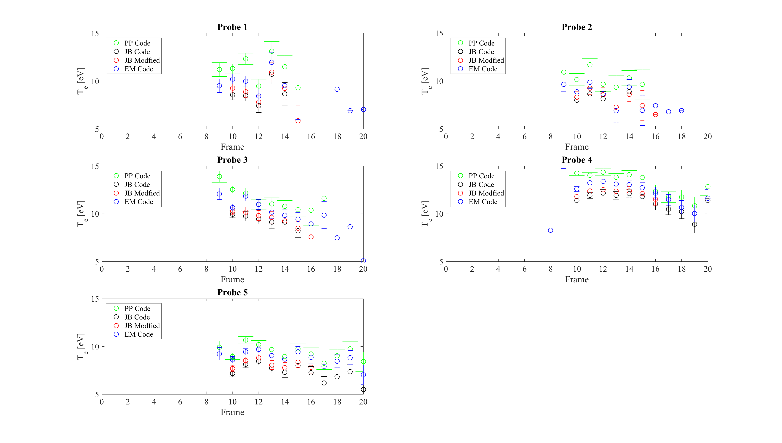
How my analysis compares to others.

Slide 7
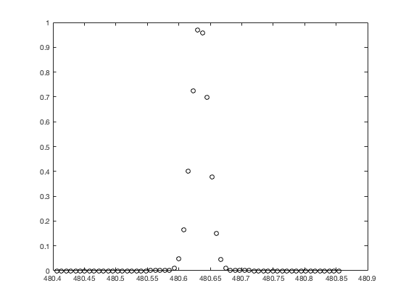
Error Analysis Added

Slide 8
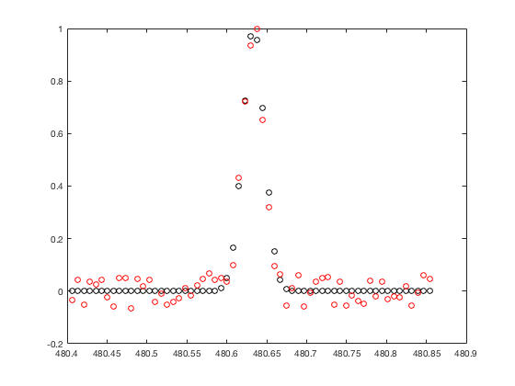
Error Analysis Added

Slide 9
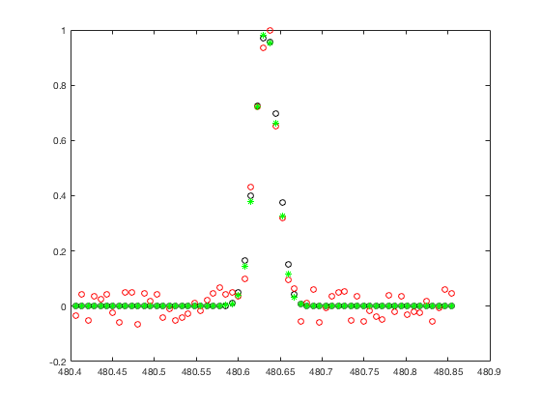
Error Analysis Added

Slide 10
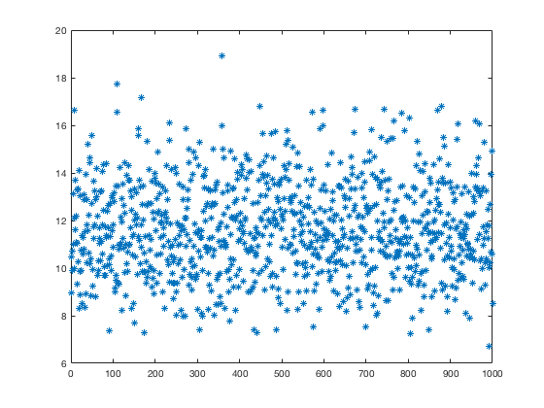
Do this 1000 times

Slide 11
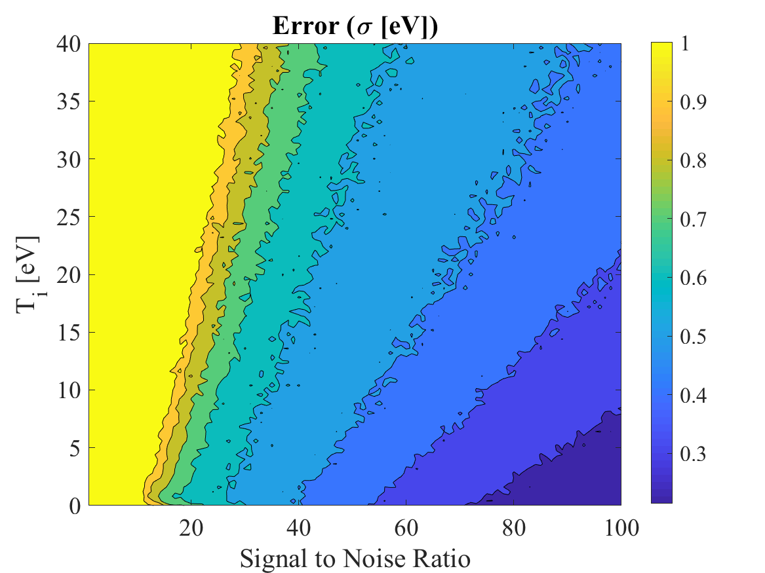
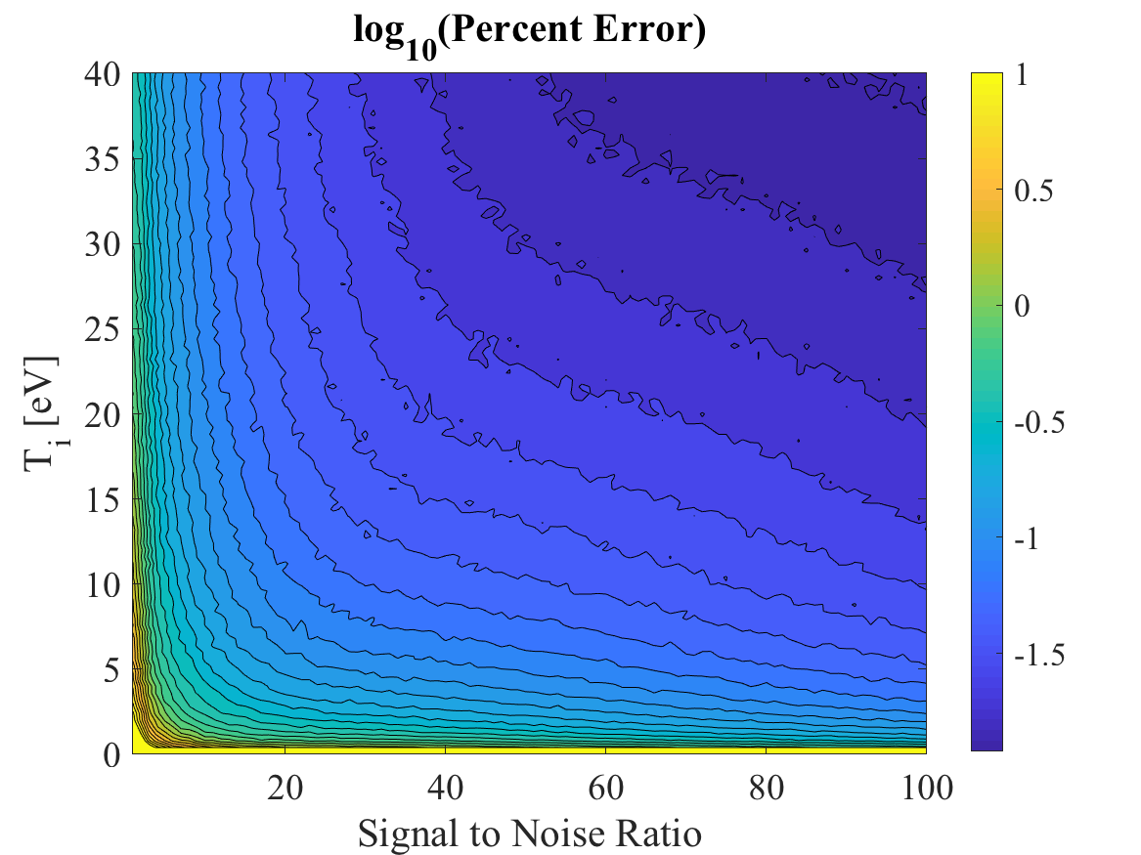
Also did some error analysis
”Monte Carlo” simulation used to predict error based on signal to noise ratio and electron temperature.
Essentially ran “simulated” gaussian and added random noise with an amplitude given by the Signal to Noise ratio.
Basically we shouldn’t trust measurements with a signal to noise of significantly less than 10.
  I define Signal to Noise strangely so I can tell you more about this.
But essentially these contours can serve as interpolation tables and add error bars to each set of data.

Slide 12
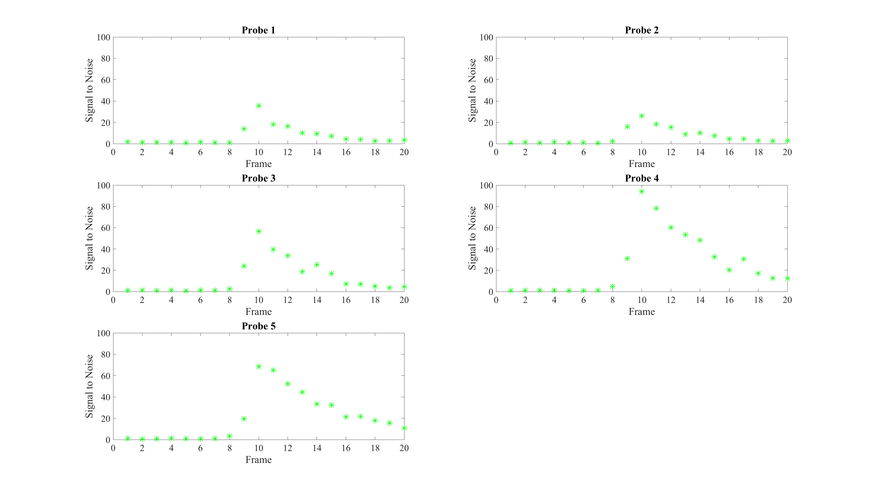
What does a Signal to Noise look like throughout our shots? Well for this shot it is:

